Slide 1

ECE 802, Electric Motor Control Permanent-Magnet Ac Machines with Non-Sinusoidal Back-Emf
P.L. Chapman, S.D. Sudhoff, and C.A. Whitcomb, “Multiple Reference Frame Analysis of Non-Sinusoidal Brushless Dc Drives,” IEEE Transactions on Energy Conversion, volume 14, number 3, pages 440-446, September 1999.

Slide 2
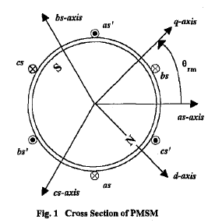
PMSM Geometry

Slide 3
Flux Linkages in a-b-c
re-write as
where
compress equations

Slide 4
Transform to xθ_{r} Reference Frame

Slide 5
Magnet Flux Linkage (Rotor Reference Frame)
x=1, n=1
fundamental component in the d-axis
x=1, n=2
third harmonic in the zero sequence

Slide 6
Magnet Flux Linkage (Rotor Reference Frame)
x=1, n=3
fifth harmonic, negative sequence
x=1, n=4
seventh harmonic, positive sequence

Slide 7
General Form for q- and d-axis Flux Linkages
Note:
paper uses n instead of m

Slide 8
Flux Linkage Example
d-axis flux linkage with m = 1
with x = 1
with x = -5
with x = 7

Slide 9
Averaged Flux Linkages
averaging over 1/6th of a fundamental cycle of θ_{r}

Slide 10
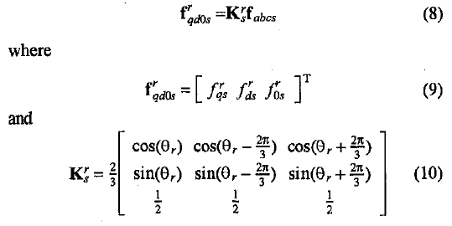
Rotor Reference Frame

Slide 11
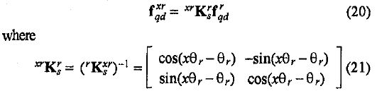
Rotor to xr Reference Frame Transformation

Slide 12
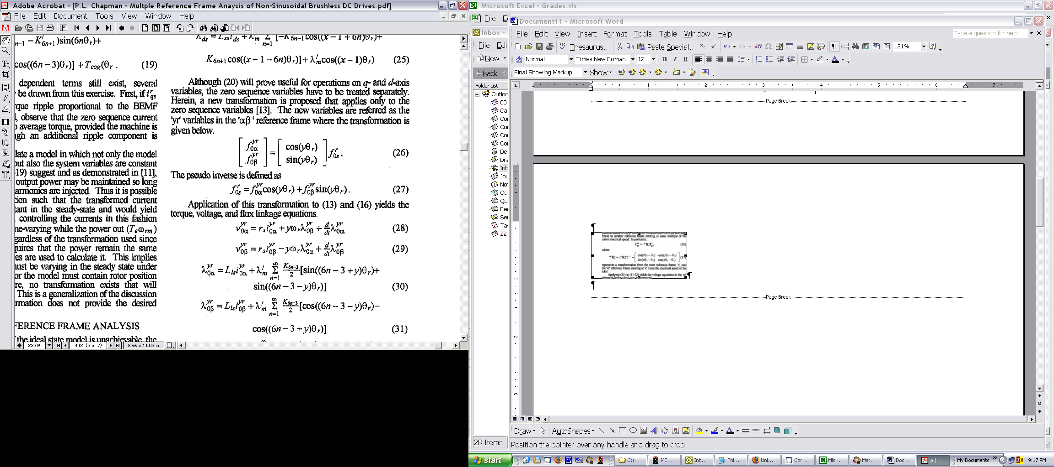
Zero Sequence Transformation
The zero sequence transformation is similar to the trigonometric Fourier series and preserves the zero sequence components

Slide 13
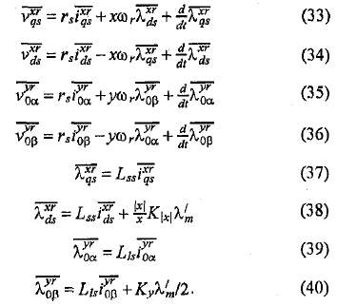
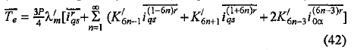
Voltage and Flux Equations in the x Reference Frame
torque

Slide 14
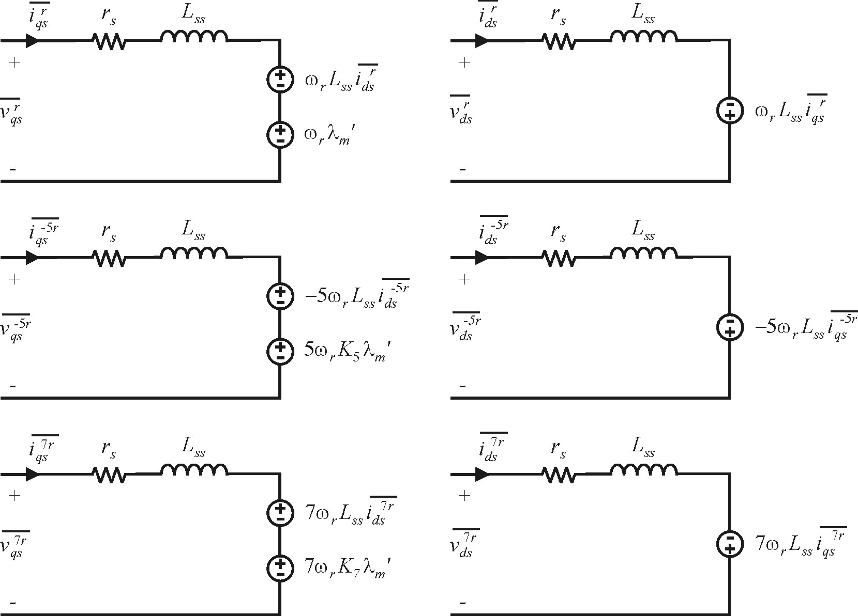
Equivalent Circuit with x = 1, -5, 7

Slide 15
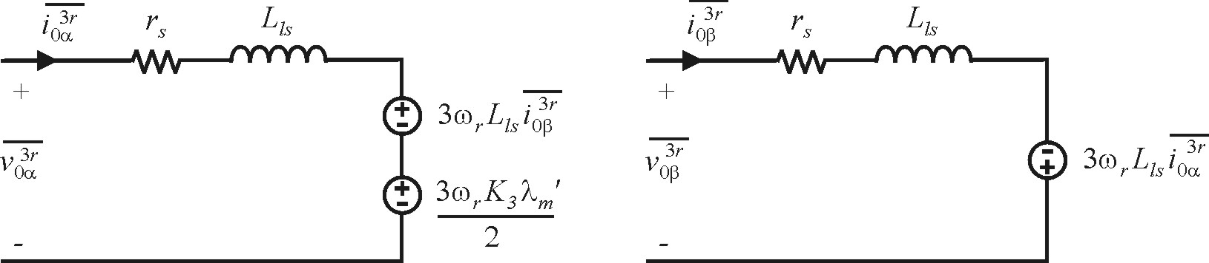
Zero Sequence Circuit with y = 3

Slide 16
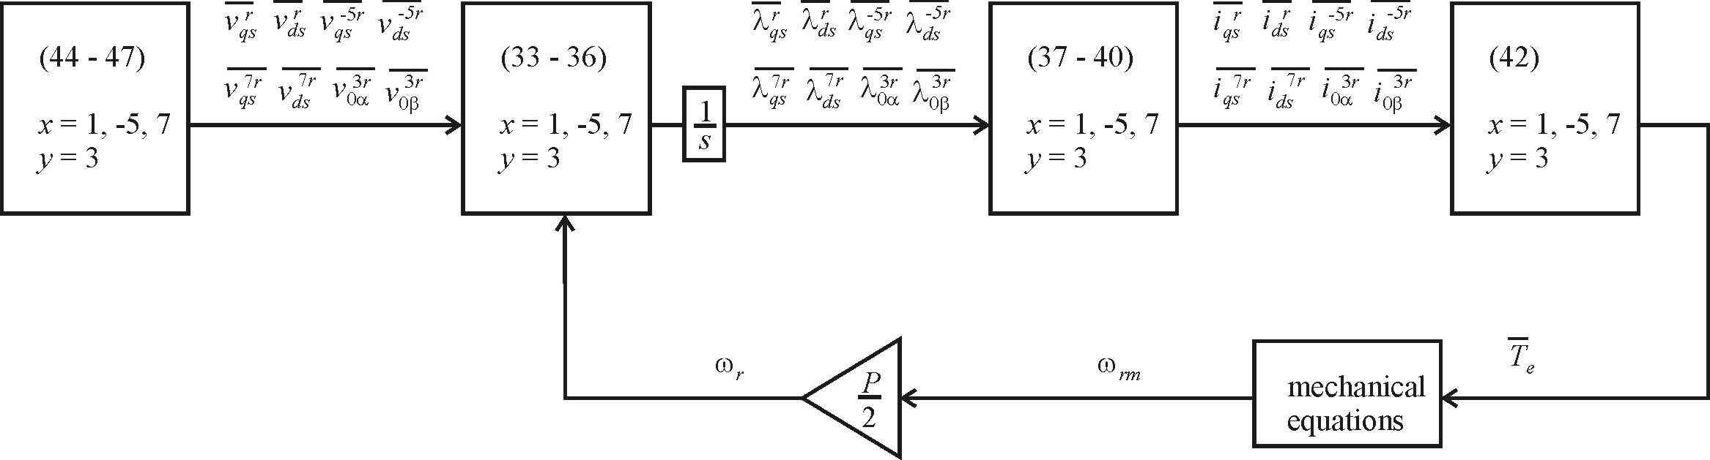
Simulation Diagram
x = 1, -5, 7
y = 3

Slide 17
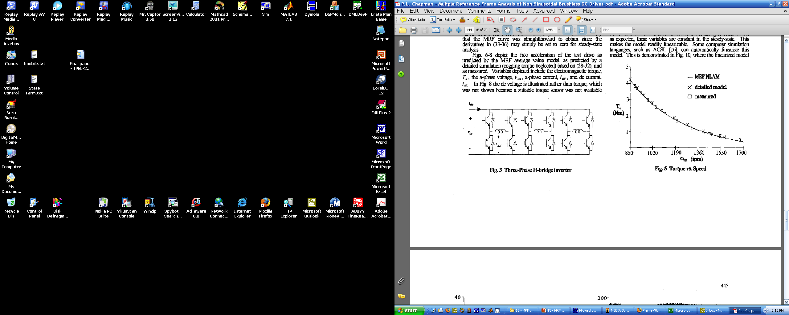
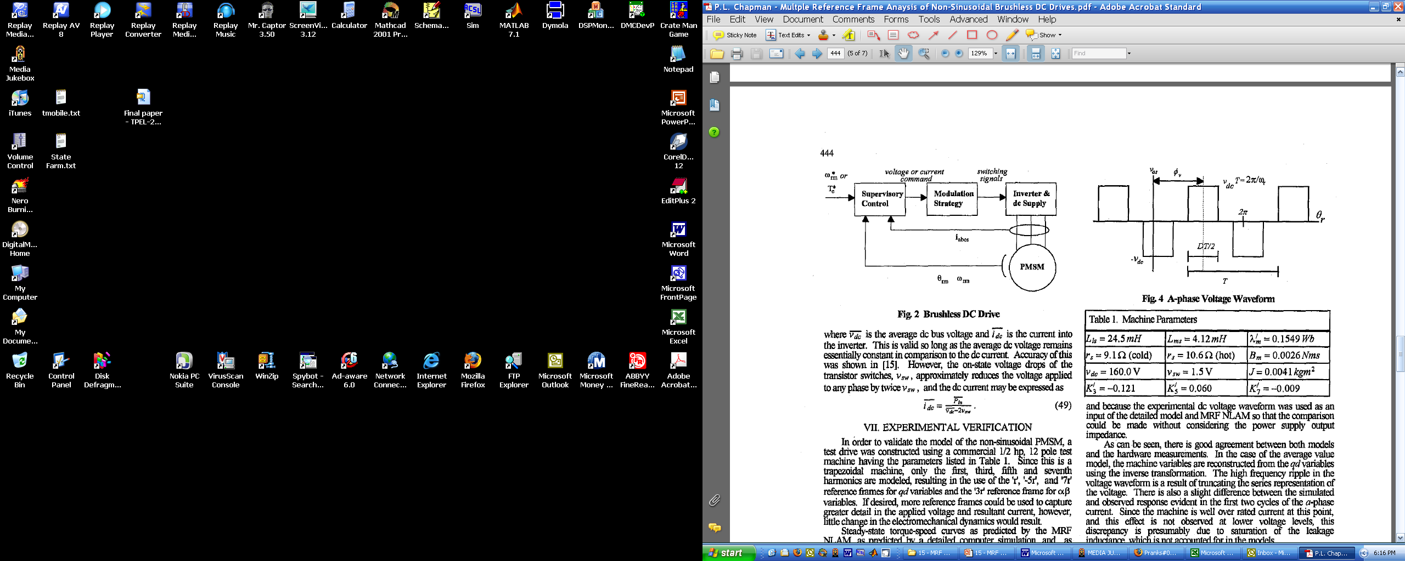
Inverter Topology

Slide 18
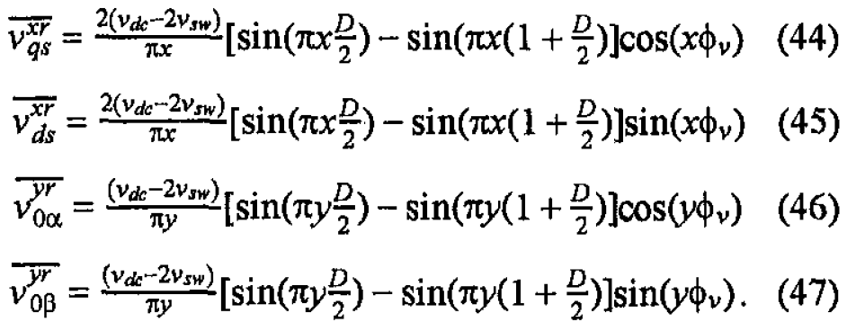
Drive Voltage Equations

Slide 19
Steady-State Calculations

Slide 21
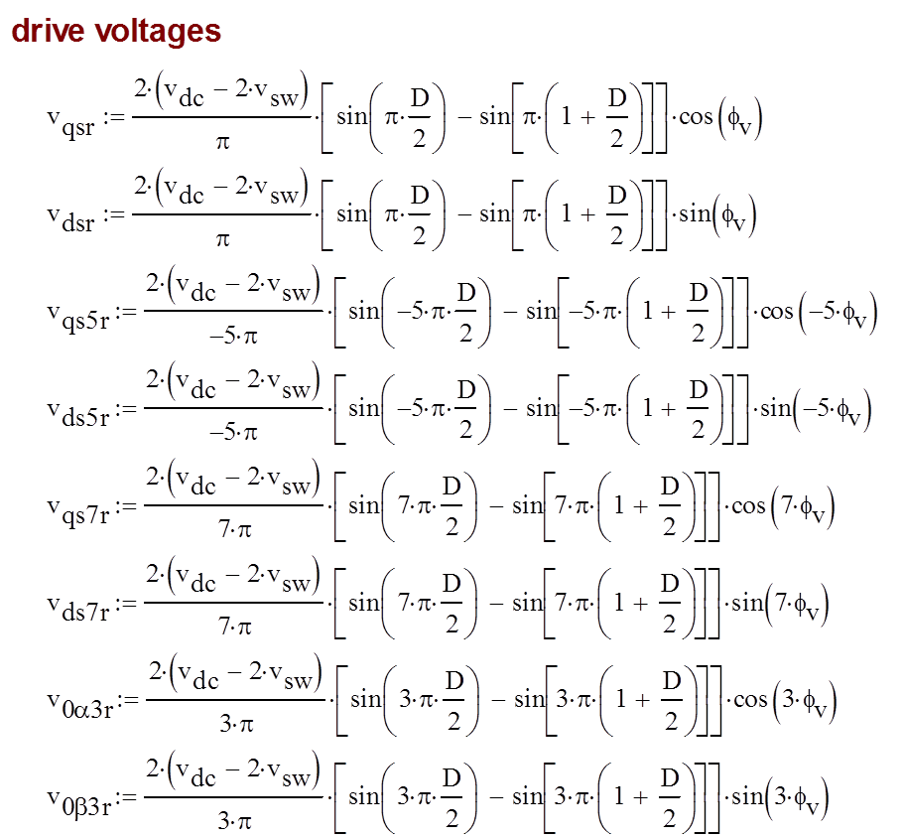

Slide 22
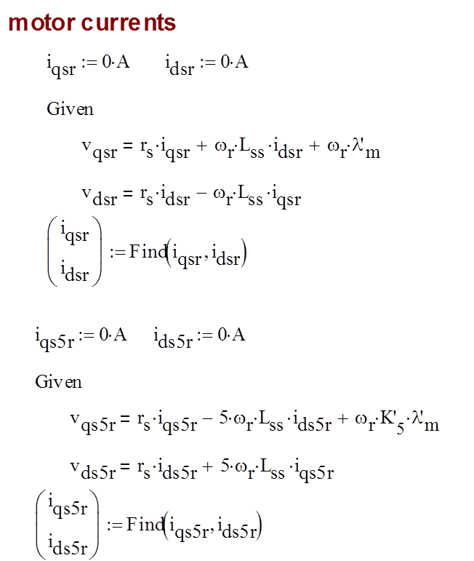

Slide 23
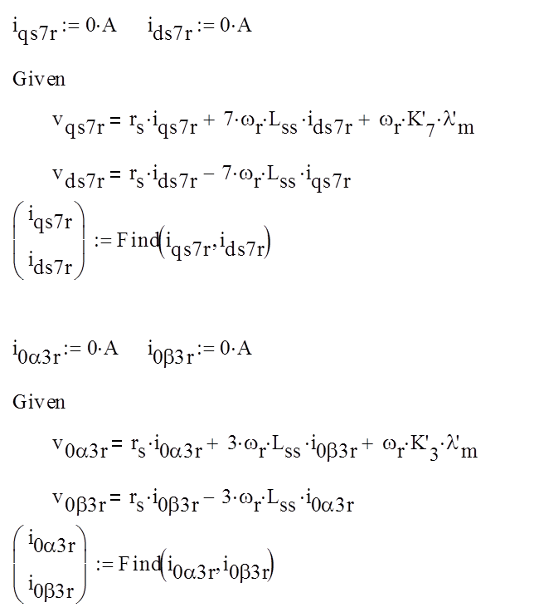

Slide 24
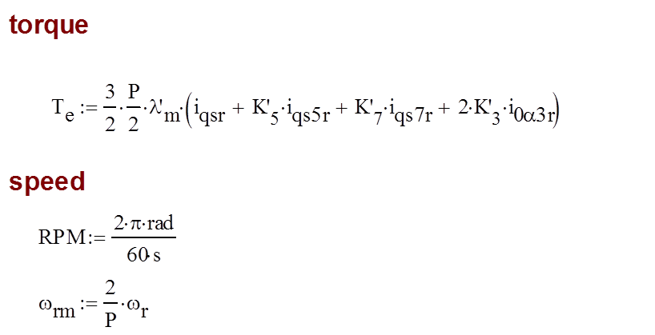
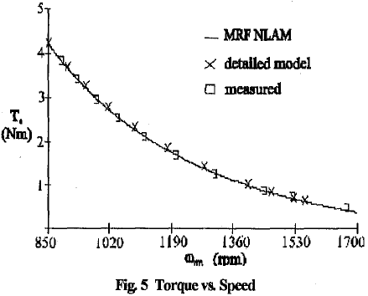

Slide 25
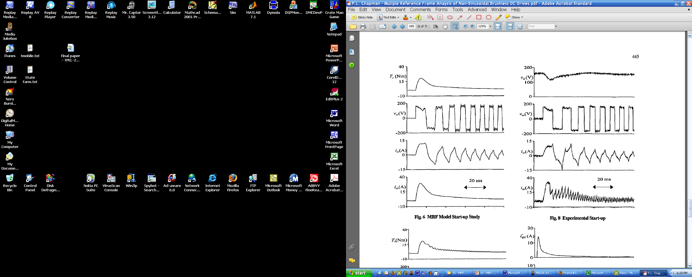
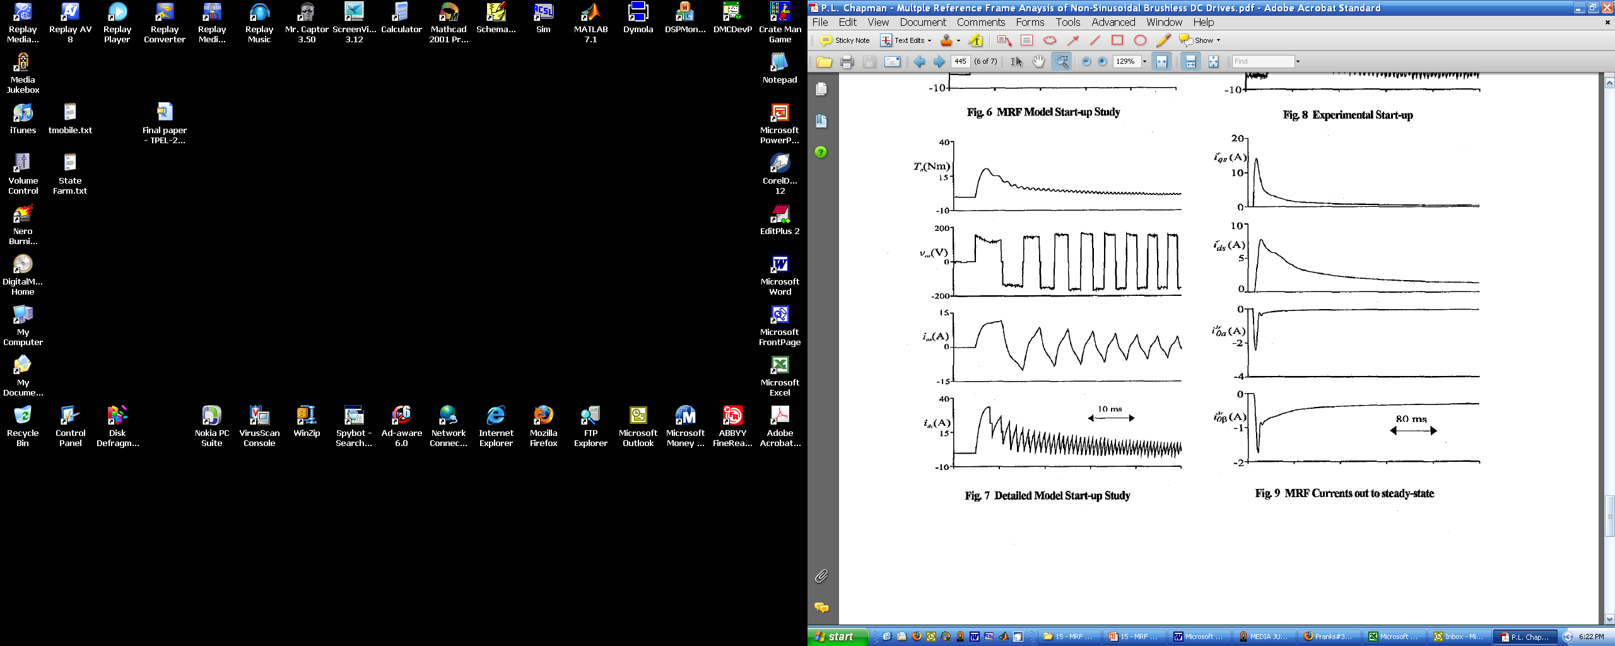
Lab Measurement and Detailed Model

Slide 26
Lab Measurement and MRF Model

Slide 27
MRF Model Currents

